Slide 1


Title
Meta Back-End Developer Professional Certificate (COURSERA)

Slide 2
Agenda
Overview of program
Key topics covered
Project work completed
Skills gained

Slide 3
Overview of program
Meta Back-End Developer Professional Certificate Internship duration: 4 weeks Provided hands-on training in:
Development fundamentals
Core Java programming
Databases
Version control with Git/GitHub

Slide 4

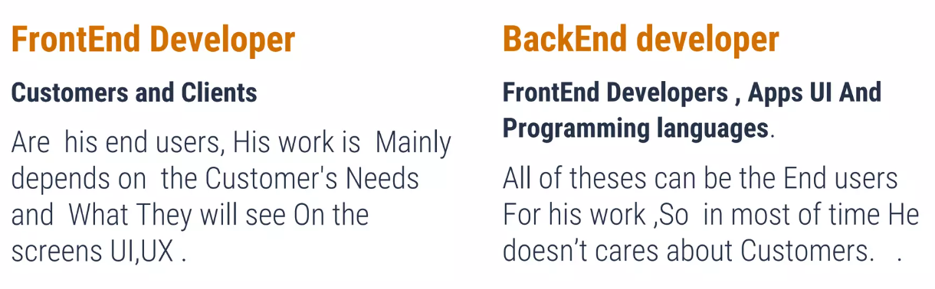
Introduction to Front-End & Back-End Development
Front-End vs. Back-End Developers
Learned the key differences and responsibilities of front-end and back-end developers in web development.

Slide 5
Basics Front-End
1
What is Front-End?
Front-end development refers to the client-side of web development, focusing on the user interface and presentation layer of web applications.
Some key front-end technologies include:
1. HTML - Provides structure and content for webpages
2. CSS - Styles and formats HTML content
3. JavaScript - Adds interactivity and dynamic behaviour
4. Front-end frameworks like React, Angular, Vue - Simplifies front-end development
5. UI libraries like Bootstrap - Provides reusable interface components

Slide 6
Introduction to Front-End frameworks
2
Benefits of UI Frameworks
Explored the advantages of working with UI frameworks like React and Angular for efficient front-end development.
1. Faster development - UI components allow for rapid building of user interfaces
2. Responsive design - Adaptive to different devices and screen sizes
3. Popular community - Large user base provides learning resources and support
4. Saves time - No need to code basic UI elements from scratch
5. Clean code - Implements separation of concerns and best practices
6. Future proof - Framework improvements keep pace with emerging UI needs

Slide 7
Back-End
1
What is Back-End?
The backend refers to the server-side of a web application and includes all the behind-the-scenes logic and infrastructure.
2
What is need of it?
1. It powers the core functionality and capabilities of a web app.
2. It handles data storage and access, business logic, APIs, security, and more.
3. The front-end depends on the backend to deliver dynamic content, enable interactivity, connect to databases, and process user requests.
4. It ensures smooth technical operation of the application.
5. Back-end code is executed on the server before results are sent to the client.
6. It provides scalability and maintenance of the application.

Slide 8
Technologies used in Back-End
List of tools used to develop business logic
1. Java - Primary backend language for logic and processing
2. Spring Framework - Popular Java framework for enterprise applications
3. Hibernate - ORM library for database access in Java
4. MySQL, PostgreSQL, etc - Relational database management systems
5. MongoDB, Cassandra - NoSQL/non-relational database solutions
6.Tomcat - Java web server and servlet container
7. JSP – Java Server Pages
8. Git - Version control system
9. Docker - Containerization technology for deployment

Slide 9

Programming in Java
1
Java Fundamentals
Studied the core concepts of Java programming, including variables, data types, conditional statements, functions, loops, interfaces, collections, socket programming, AWT and Swing Framework.
2
Object-Oriented Programming
Explored the principles of object-oriented programming: encapsulation, inheritance, polymorphism, and abstraction.

Slide 10

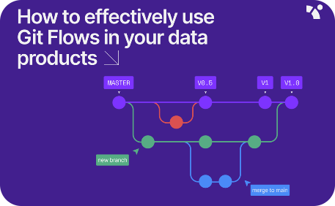
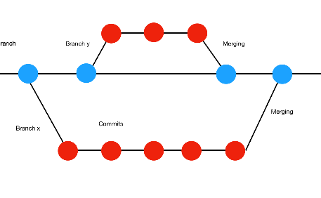
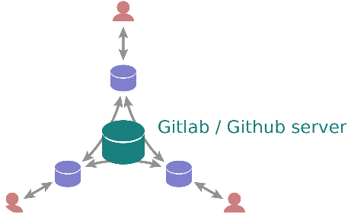
Version Control
Learned the importance of version control and how to effectively use Git, enabling collaboration and tracking changes in a development project.
Git Basics
Branching and Merging
Remote Repositories
Learn the basics of version control with Git and its importance in collaborative software development.
Discover branching strategies and techniques to manage parallel development efforts.
Explore remote repositories and their role in distributed version control systems.

Slide 11
Common GIT commands & their usage
Here are some common Git commands and their usage:
1. git init - Initializes a new local Git repository
2. git clone - Clones/copies a remote repository to your local machine
3. git add - Stages files to be committed
4. git commit - Records changes to the local repository with a commit message
5. git push - Pushes local commits to the remote repository
6. git pull - Pulls latest commits from the remote repo to local repo
7. git status - Views state of files and changes in working directory
8. git log - Shows commit history and details
9. git branch - Lists, creates, or deletes branches
10. git checkout - Switches between branches
11. git merge - Merges branch with current working branch

Slide 12

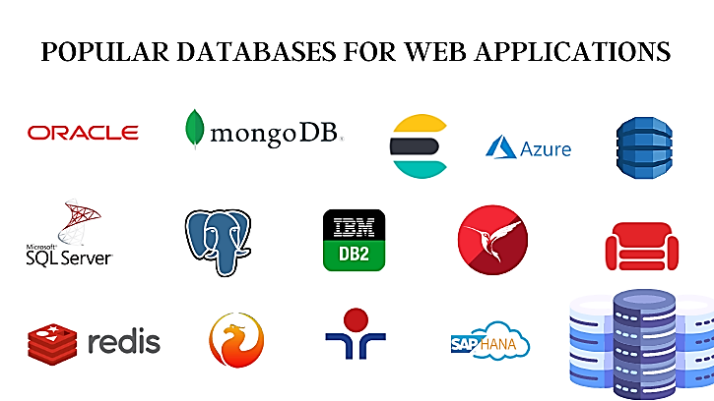
Introduction to Databases for Back-End Development
Explored the fundamentals of database management systems (DBMS) and the role of databases in back-end development. Learned SQL to manipulate and query data.

Slide 13

Capstone Project: Chat Application
Developed a chat application using Java Swing, AWT, and Socket Programming. This project involved building a client-server chat system with real-time messaging functionality.

Slide 14
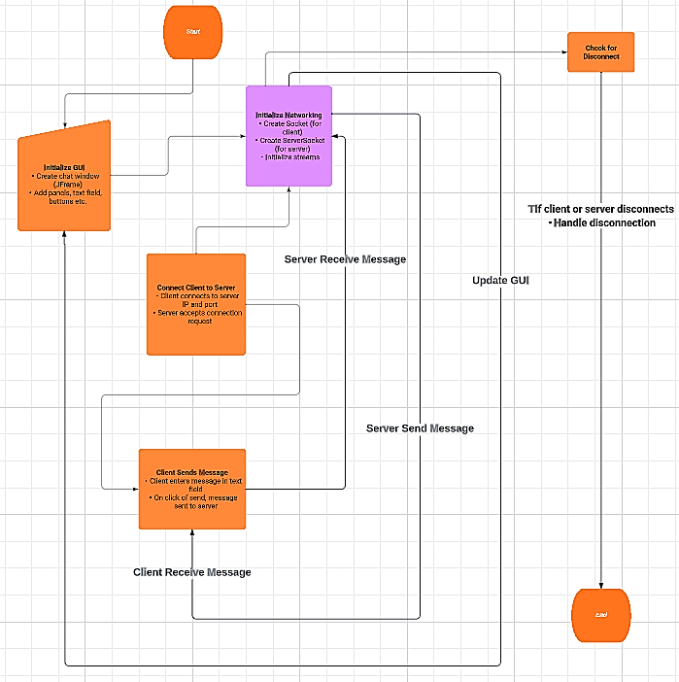
Flowchart

Slide 15
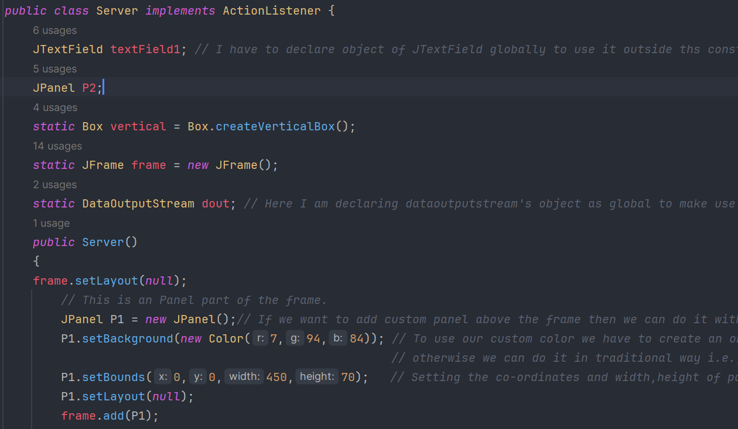
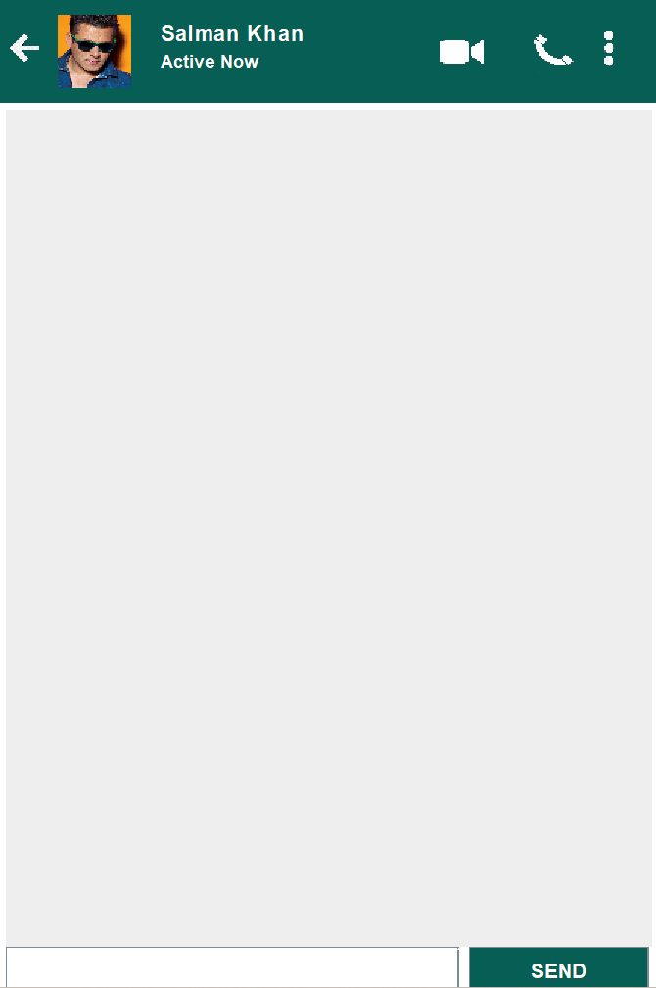
Project Implementation Steps
1. Initializing Server:

Slide 16
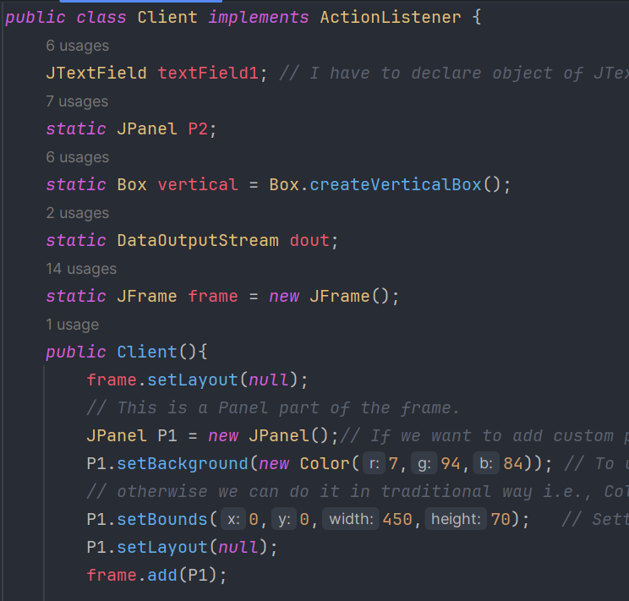
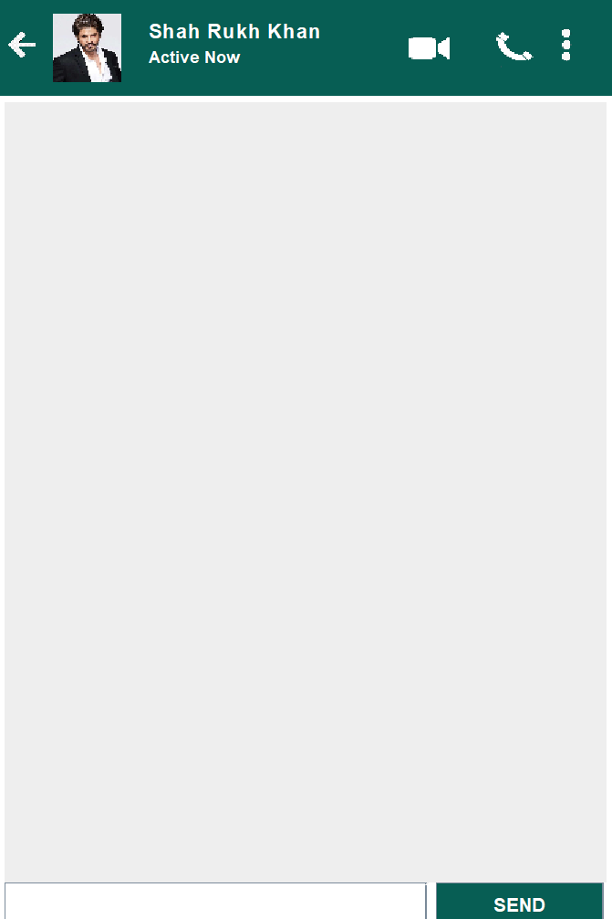
Project Implementation Steps
2. Initializing Client:

Slide 17
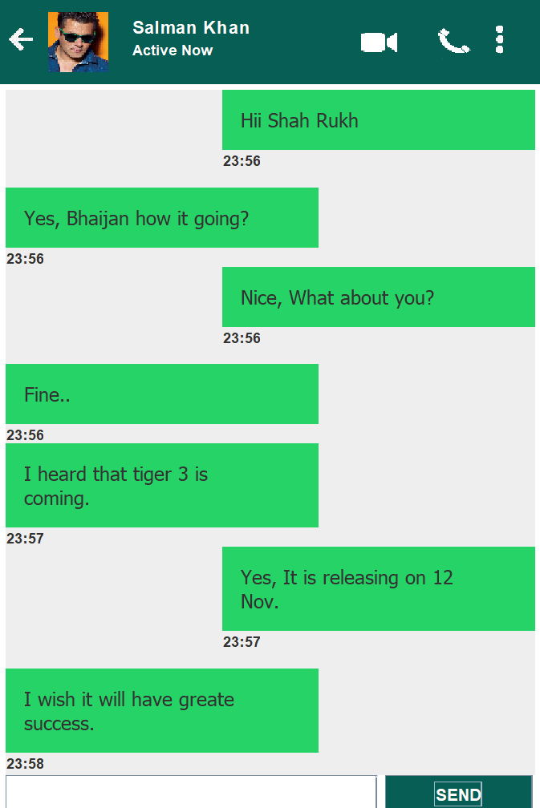
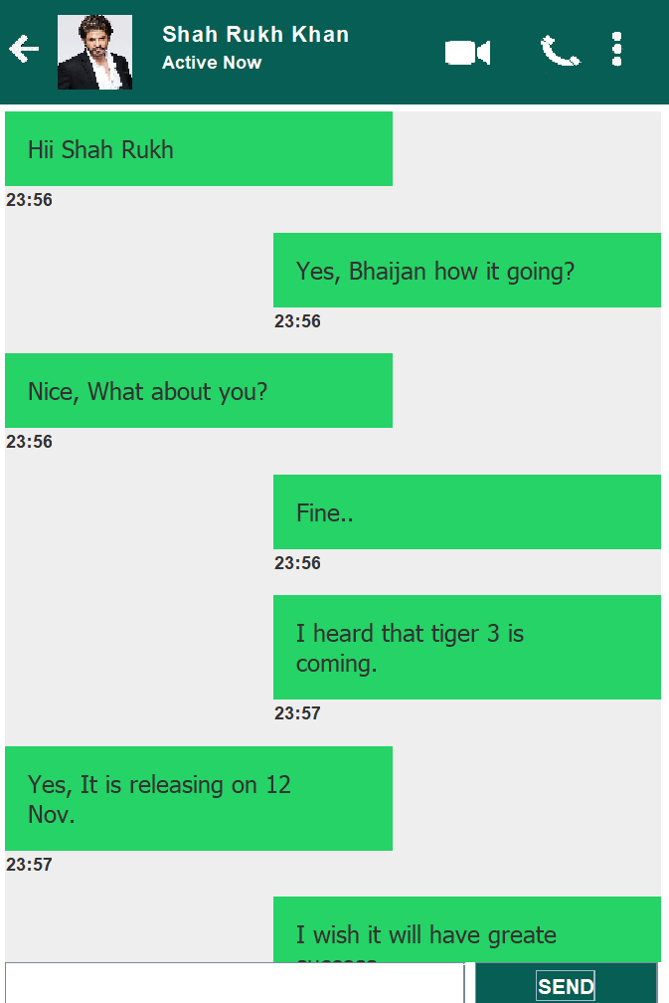
Project Implementation Steps
3. Final Output (Conversation)

Slide 18


Conclusion
New Skills and Knowledge
Gained valuable hands-on experience in the field of back-end development, equipped with essential skills and knowledge.
Networking Opportunities
Had the chance to connect and collaborate with professionals, expanding my professional network in the industry.
Career Growth
Prepared to embark on an exciting career journey as a back-end developer, confident in my abilities and ready for future opportunities.

